Slide 1
Title I Annual Parent Meeting
Woodlawn Elementary School
August 30, 2023
Principal: Vickie Graham
Assistant Principal: Gwendetta Richards
Notes:
Welcome Fuguitt Families!

Slide 2
Title I Annual Meeting Agenda
Woodlawn Elementary
Welcome and Introductions
About Title I – Ms. Graham
What is Title I?
Title I Supplemental Support
Title I Funding
Title I Schoolwide Planning
Title I Schoolwide & Parent and Family Engagement (PFEP)
Budgets
Parents’ Right to Know
Questions? Don’t forget to take our survey!
Together, will accomplish great things!

Slide 3
Title I Annual Meeting Agenda
Woodlawn Elementary
Working Together for Student Success -
Review Title I Parent-School-Student Compact
Pinellas County Schools Parent and Family Engagement Plan (PFEP)
Parent Advisory Council (PAC) Rep Needed
Ms. Richards
Standards
Curriculum
Assessments

Slide 4
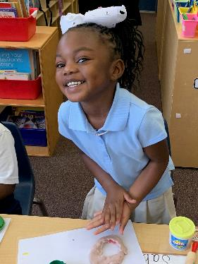
About Title I
Title I is the largest federal assistance program for our nation’s schools.
The goal of Title I is a higher quality of education for every child. Its purpose is to address the academic needs of students and to assist them in meeting their state’s academic standards.
The program serves millions of children in public elementary and secondary schools each year including eligible students in non-public schools. The program serves 75 schools in Pinellas County including eligible students in 34 non-public schools.

Slide 5
Title I Schoolwide Planning
Input from school, family, and community members determine how Title I funds are used based on a needs assessment.
Please attend our in-person meetings/trainings and complete surveys to provide input on Title I funding.
All Title I schools must document that parents are involved in the schoolwide planning process.
Notes:
Decisions and Planning on How to Use Title I funds based on needs assessment.

Slide 6
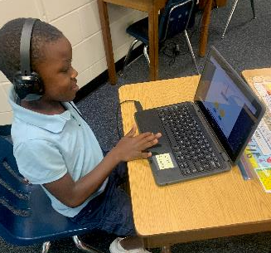
Title I Schoolwide Budget
Woodlawn Elementary is provided funds to pay for supplemental resources and programs for increased student achievement.
Total Allocation $141,000.00

Slide 7
Title I Programs Provide Supplemental Support
* Community & Family Liaison
* * MTSS Coach
* Reading Recovery Teachers
Extended Learning Opportunities (before and/or after school programs)
Parent and Family Engagement Resources
and Training Workshops
Audit Box – Ashley Digregorio
Supplemental teaching materials, equipment, and technology
Notes:
Title I funds are used to supplement the program at the school by providing funds which support the following types of activities:
*MTSS Coach works with teachers to identify and train on interventions, curriculum strategies and assists with providing direct instruction to students.
Additional teachers and paraprofessionals to create smaller classes
Additional training for school staff
Extra time for instruction (Before and/or after school programs)
Parent and Family Engagement Activities
A variety of supplemental teaching methods and materials

Slide 8
Title I Schoolwide Budget
School's Title I Parent & Family Engagement 23-24 Budget
100% Family Engagement Resources - Total Allocation $6,699.00
Parent & Family Engagement Plan (PFEP)

Slide 9
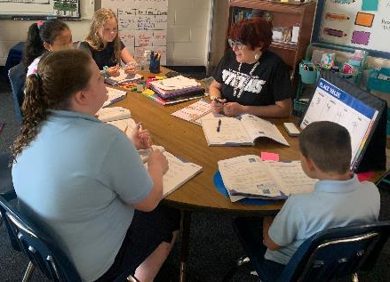
Parent’s Right to Know
As a parent of a student attending a Pinellas County Public School, you have the right to…
Be provided information on your child’s level of achievement on assessments in Reading/Language Arts, Writing, Mathematics, and Science.
Request and receive information on the qualifications of your child’s teacher and supplemental personnel working with your child.
Be notified of non-highly qualified or out-of-field teachers at the school.
Be informed if your child is taught by a non-highly qualified teacher for four or more consecutive weeks.
Notes:
Principal’s Attestation provides the number of teachers that are non highly qualified or teaching out of field
Parents Rights under ESEA
Request the qualifications of your child’s teacher
Be notified if your child is taught for more than 4 consecutive weeks by a teacher who is not highly qualified
Request opportunities for regular meetings with staff in order to make suggestions
Participate in decisions relating to the education of your child
Submit a written comment on the school-wide program plan when the school makes the plan available to the district (if you are not satisfied with the plan)

Slide 10
Parent’s Right to Know
Title I law requires that all Title I schools and families work together.
As a Title I parent you have the right to be involved in the development of the following plans and documents for our school:
School Improvement Plan (SIP)
Title I Schoolwide Plan
Parent and Family Engagement Plan (PFEP) for the school and district
School-Parent-Student Compact
You may request and attend virtual or in-person meetings to express your opinions and to formulate suggestions and to participate, as appropriate, in decisions relating to the education of your children.
Notes:
Discuss timeline and how does your school gather input. (Surveys, suggestion box, links to school personnel
Title I Schoolwide Plan should only include Comprehensive Needs Assessment, Areas of Focus, Program Implementation, Professional Development (No names or salaries)

Slide 11
Working Together for Student Success
Where are these documents located?
Please review these documents at the Parent Station in the front office and the school and district websites. We invite you to attend meetings or complete surveys to share your input…we need and want you to be involved.
Check out our website https://www.pcsb.org/woodlawn-es to view:
School Improvement Plan (SIP)
Title I Schoolwide Plan
School Level Parent and Family Engagement Plan (PFEP)
Parent-School-Student Compact
Pinellas County School’s Parent and Family Engagement Plan at www.pcsb.org/titleone and a summary is written in, “Title I Family & School Partnership Overview”, which is given to all Title I families.
Notes:
Section 1112 of ESEA requires meaningful involvement of parents in the decisions made at the school. Specifically, parents are required to be involved in the development, implementation, review and revisions of the Parent and Family Engagement Plan, School-wide Plan (School Improvement Plan) and the Parent-School Compact. Parents are also required to be involved in the development of district wide policies.
Title I District Parent and Family Engagement Plan– how the district involves parents and families and build schools’ and parents’ capacity for strong parent and family engagement and to help their children succeed. Must be reviewed and revised annually with parents.
Explain that Title I parents can be involved in reviewing and updating the policy each year (provide the dates/times for the virtual meeting if available)

Slide 12
Parent-School-Student Compact
Every Title I school has a Compact or Agreement.
The purpose of the compact is to foster student achievement. By signing the Parent-School-Student Compact, Woodlawn Elementary teachers, staff, parents and students agree to work together to share the responsibility of helping students meet or exceed state, district and school academic goals.
The Parent-School-Student Compact is updated every year to include parent, student, teacher, and staff input. Parent, student, teacher and staff comments are welcome at any time during the year.
Please review and sign your child’s Compact.
Our goal is to receive 100% participation!
Notes:
Title I School-Parent-Student Compact – outlines how parents, the entire school staff, and students will share the responsibility for improved student academic achievement. Must be reviewed and revised annually with parents.
Explain that Title I parents can be involved in reviewing and updating the school/parent policy each year (provide the dates/times for the meeting if available)

Slide 13
Parent and Family Engagement Plan (PFEP)
The PFEP Sections include information about the following:
Parent trainings to increase student achievement
Staff trainings for engaging parents
Communication methods between home and school
Flexible meeting times
Accessibility for parents
Coordinating with other Federal Programs
Notes:
Provide information on the specific committees that parents can be involved. Include the purpose, date and time of meetings.
Explain the PFEP and its purpose.

Slide 14
Parent Advisory Council (PAC)
The District has a Parent and Family Engagement Plan. The summary of the this plan is in the Title I School & Family Partnership Overview.
You may access the full plan at www.pcsb.org/titleone
The Parent Advisory Council (PAC) is responsible for reviewing and revising the District PFEP.
PAC will meet virtually or in-person with the district’s Title I Family Education Coordinator.
PAC meets twice a year, if you are interested in representing our school please notify, Ms. Thomas in our front office.
Notes:
Please add your PAC representative in slide and email Amy Brown the contact at dodgeam@pcsb.org

Slide 15
Accountability
School Report Cards
School Grade and Overview
Population and Enrollment
Assessments – Academic Achievement, Growth, and Population
Assessments – English Language Learners, ACCESS testing
Graduation and Beyond
Educator Qualifications and Equity
Long-Term Goals and Interim Progress
Accelerated Course Enrollment
Per-Pupil Expenditures
National Data
Available online at https://edudata.fldoe.org/ or Front Office

Slide 16
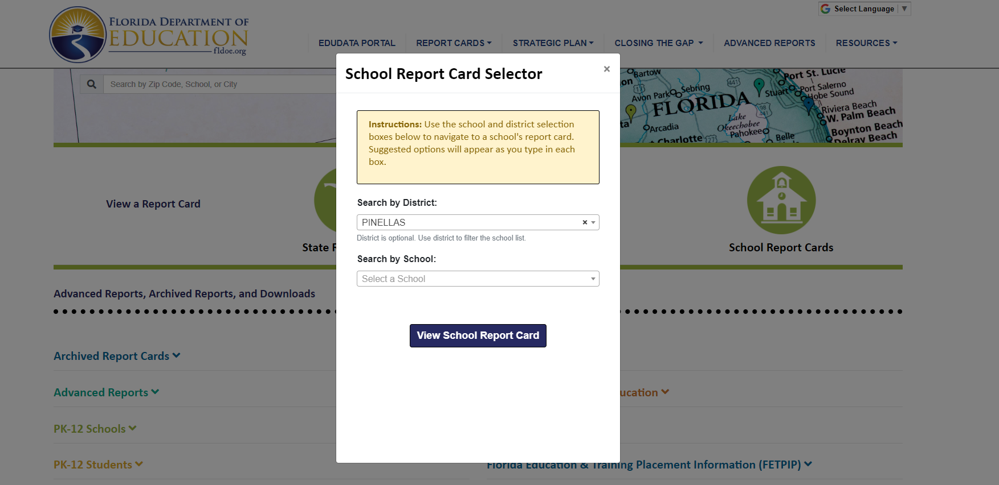
Visit to find district and school grades, EduData Portal
Notes:
When you follow the link EduDataPortal select Pinellas County and search by school.

Slide 17
Florida Standards
Florida’s academic content standards establish high expectations for all students. These are now called the B.E.S.T. Benchmark for Excellent Student Thinking
Florida Standards identify what your child needs to know and be able to do in all content areas. You may read more information by visiting fldoe.org/academic/standards/.
Your child’s teacher will be able to explain the standards for your child’s grade level.
Notes:
All curriculum, instruction and assessments are based on student-centered expectations.

Slide 18
School’s Curriculum
Florida’s B.E.S.T. Standards form the framework of everything taught at school.
Curriculum
Reading
Mathematics
Writing
Science
Notes:
This slide is optional if this will be discussed with classroom teacher
School’s Curriculum
Describe and explain the curriculum (Specific names of texts)

Slide 19
Florida Benchmark For Excellent Student Thinking Standards (B.E.S.T). You may read more information by visiting, http://www.fldoe.org/standardsreview/
Florida’s B.E.S.T. Standards form the framework of everything taught at school. Reading, Writing and Math. Science follow NGSSS Next Generation Sunshine State Standards
Notes:
All curriculum, instruction and assessments are based on student-centered expectations.

Slide 20
Florida Benchmark For Excellent Student Thinking Standards (B.E.S.T). You may read more information by visiting, http://www.fldoe.org/standardsreview/
Transition to F.A.S.T Florida Assessment of Student Thinking
Notes:
All curriculum, instruction and assessments are based on student-centered expectations.

Slide 21
New Assessment: FAST
More information can be found about the FSA Transition to FAST:
https://feaweb.org/fsa-transition-to-fast/
Source: https://www.flgov.com/2021/09/14/governor-desantis-announces-end-of-the-high-stakes-fsa-testing-to-become-the-first-state-in-the-nation-to-fully-transition-to-progress-monitoring/

Slide 22
We need your help! Active Parent Involvement
Share a love of learning
Read to and with your child
Review the Compact throughout the year
Keep Portal info up to date
Volunteer
Participate in giving your input for our SIP, PFEP, and budget
Show interest in your child’s school day
Ask her/him questions
Check homework
Praise their efforts
Encourage good study habits
Communicate with the teachers and other staff
Virtually or in-person attend events

Slide 23
We need your help! Active Parent Involvement
Opportunity for Two-Way Communication
PBIS App
Communication Folders
PCSB Email
Virtual and face-to-face conferences

Slide 24
Additional Resources
Title I Parent & Family Coordinator – thomassc@pcsb.org Schnika Thomas
Learning at Home Family Resources - https://www.pcsb.org/Page/32836
Volunteer in a Pinellas County School - https://www.pcsb.org/Page/459
Mentoring & Tutoring - This Year it's Virtual -https://www.pcsb.org/Page/461
Parent Advocacy –
Parent Academy POWER HOURS Webinars - https://www.pcsb.org/Page/26534
Partnerships - https://www.pcsb.org/Page/418

Slide 25
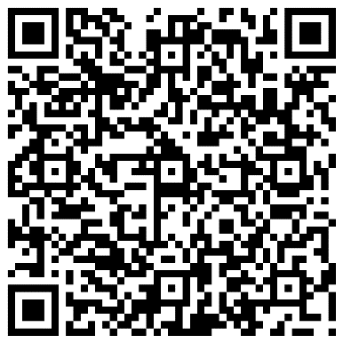
Complete this Survey
Notes:
Personalize with all ways you connect with families.

Slide 26
We appreciate your time!
Please feel free to ask any questions and provide feedback on our Title I Program. You can email me at GrahamV@pcsb.org

